Slide 1

Slide 1
🚀 E-commerce Sales Dashboard Analysis

Slide 2
📌 Business Problem
Huge daily sales data
Lack of clear visibility
Struggle to:
▪️ Find profitable segments
▪️ Control poor products
▪️ Optimize stock & price
▪️ Track payment trends
▪️ Meet sales targets
▪️ Plan local marketing
📊 Built an interactive dashboard
✅ Added a new Excel project
🎯 Focus: Uncover insights, problems, solutions

Slide 3
🔍 Key Insights
🗂️ Category-wise Sales: Top vs low categories
🌍 Region-wise Sales: High vs low regions
📦 Product-wise Sales: Best & worst products
🎯 Actual vs Target: Goal achievement

Slide 4
🔍 Key Insights
🏢 Company-wise Sales: Partner-wise totals
📌 Product Status & Price: Stock & pricing
💳 Payment Mode: Popular payment types
🗺️ State-wise Sales: State performance

Slide 5
🔍 Key Insights
👥 Gender-wise Sales: Male vs Female
🏙️ City-wise Sales: Top contributing cities
💳 Payment Mode: Popular payment types
🗺️ State-wise Sales: State performance

Slide 6

Slide 6
✅ Proposed Solutions
📈 Boost Strong Segments → More ads, stock, push
📉 Fix Weak Segments → Offers, combos, drop poor items
🎯 Bridge Gaps → Track shortfalls, tweak strategy
🗺️ Local Marketing → State/region offers, events
💳 Payment Optimization → Promote preferred modes, balance fees
👥 Gender Offers → Campaigns for Male/Female buyers
🏙️ City Focus → Local ads, quick delivery

Slide 7

🔑 Key Takeaway
Dashboard + Excel = Not just data — clear actions
Turns raw sales into a roadmap for growth
Supports smart, sustainable decisions

Slide 8
✨ What It Shows
✔️ E-commerce data flow expertise
✔️ Dashboard & Excel skills
✔️ Pattern & insight discovery
✔️ Real solutions, not just numbers
✔️ Business mindset & storytelling

Slide 9
📌 Project Info
$704.78
Type: E-commerce Dashboard | Business Insights | Excel Reporting
$191.01
$189.31
Status: Completed
$186.54
Category: Data Analysis | BI | Decision Support

Slide 10
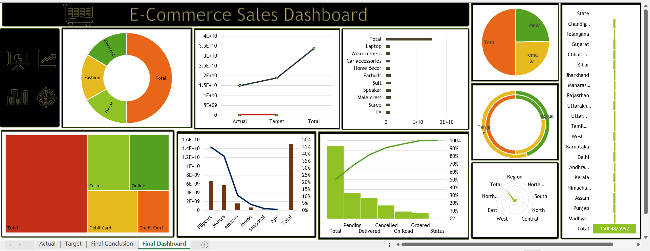
Final Dashboard

Slide 11

Slide 10
THANK YOU

